Slide 1

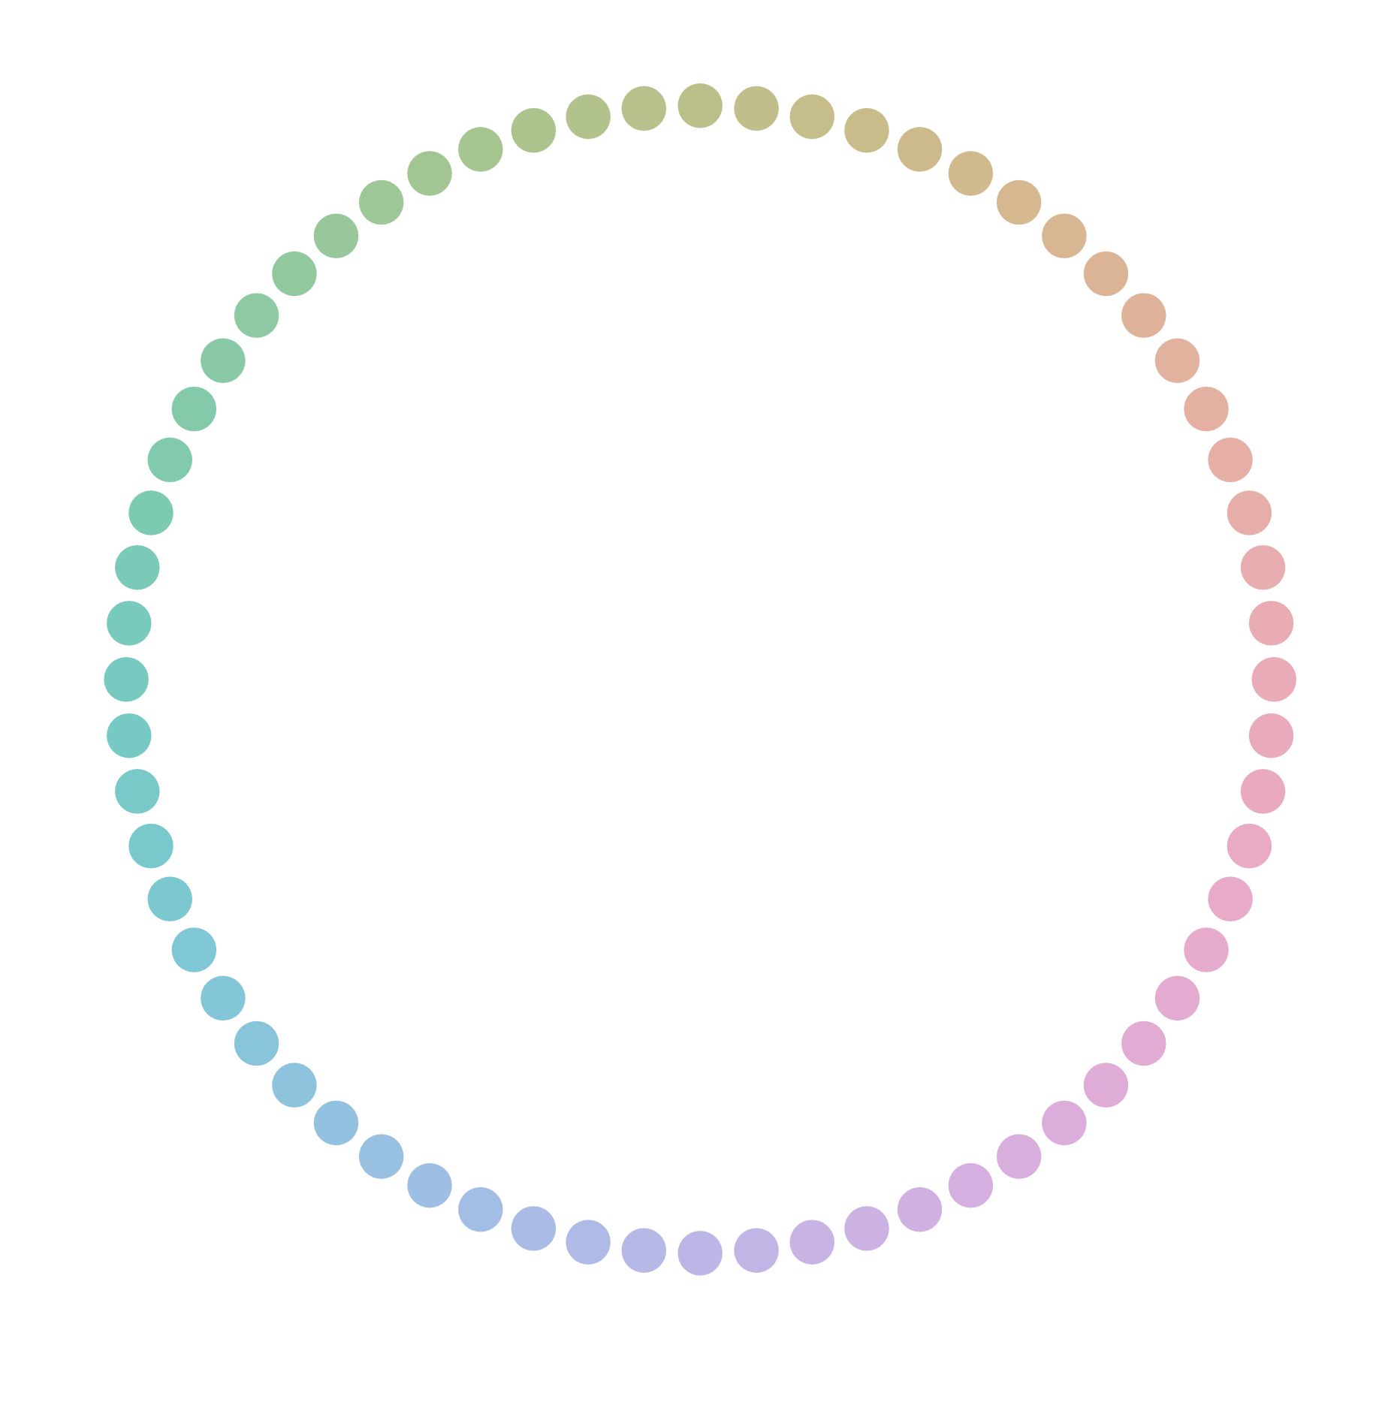
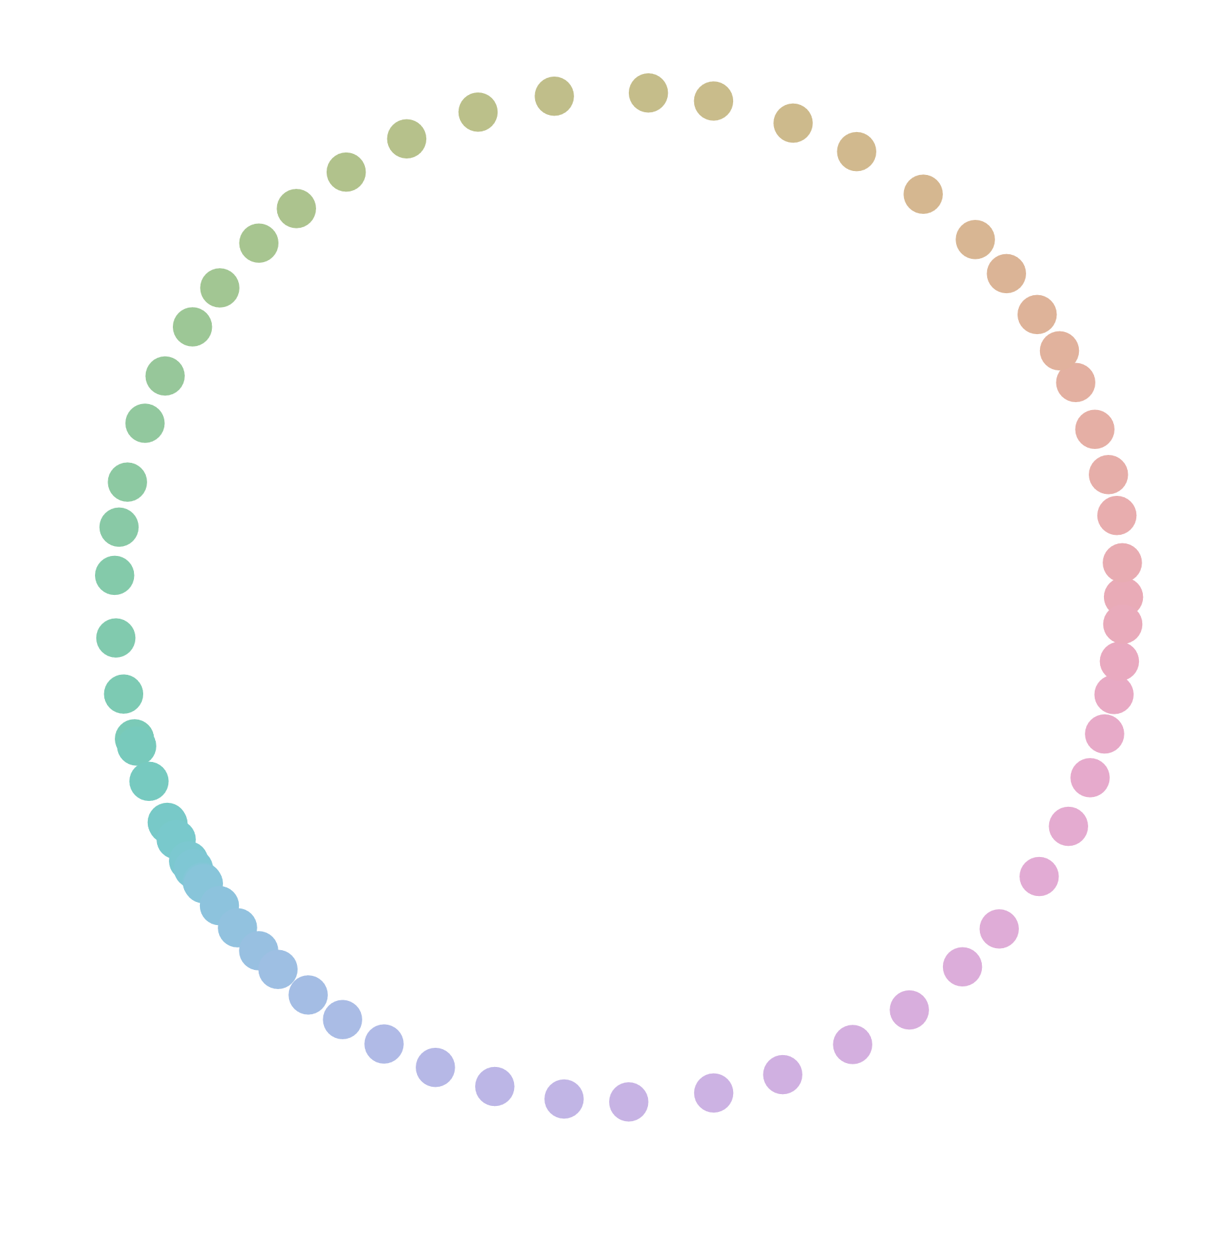
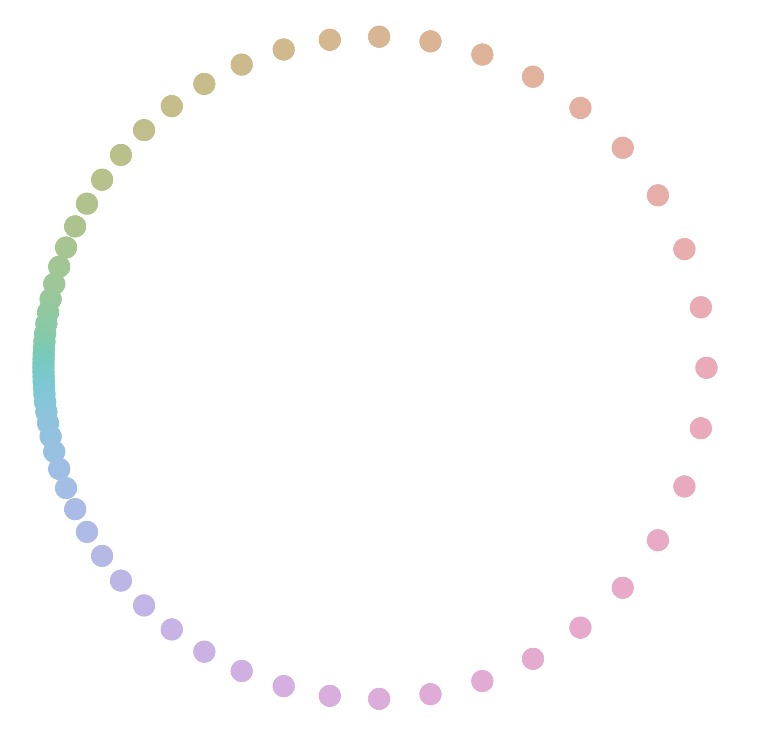
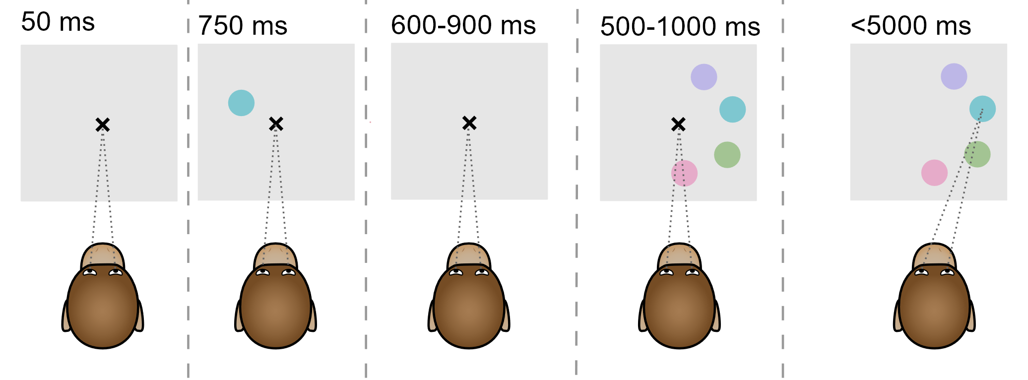
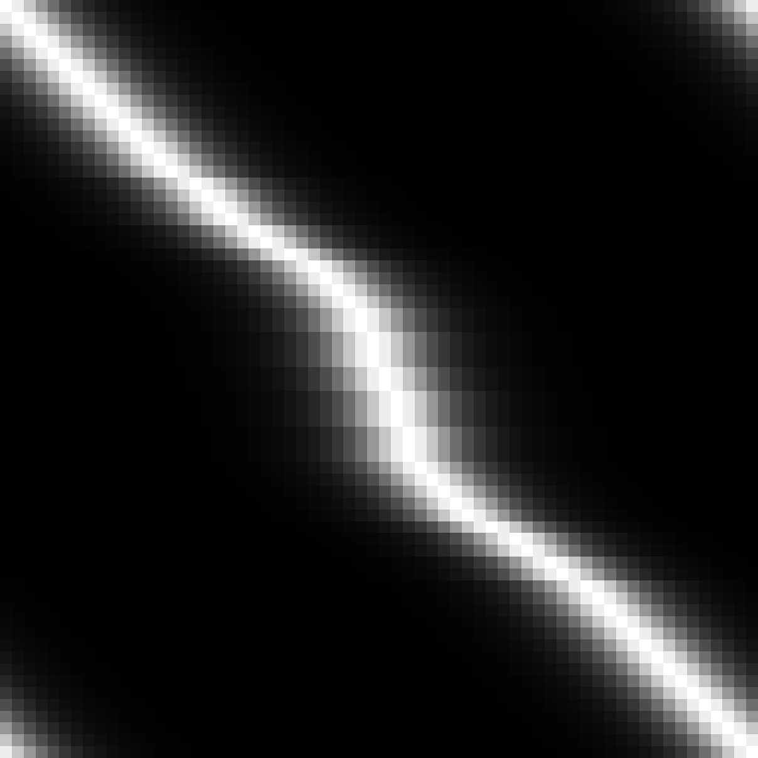
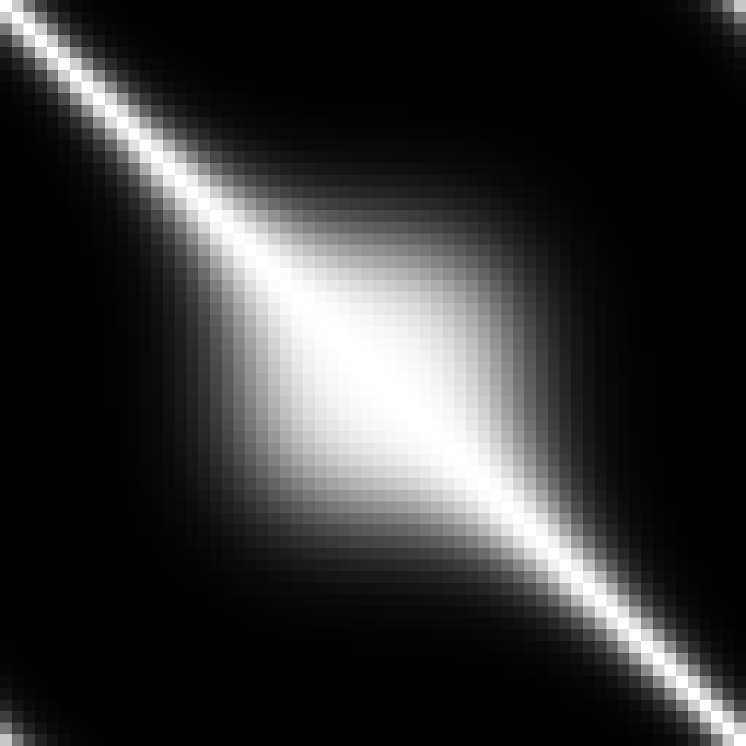

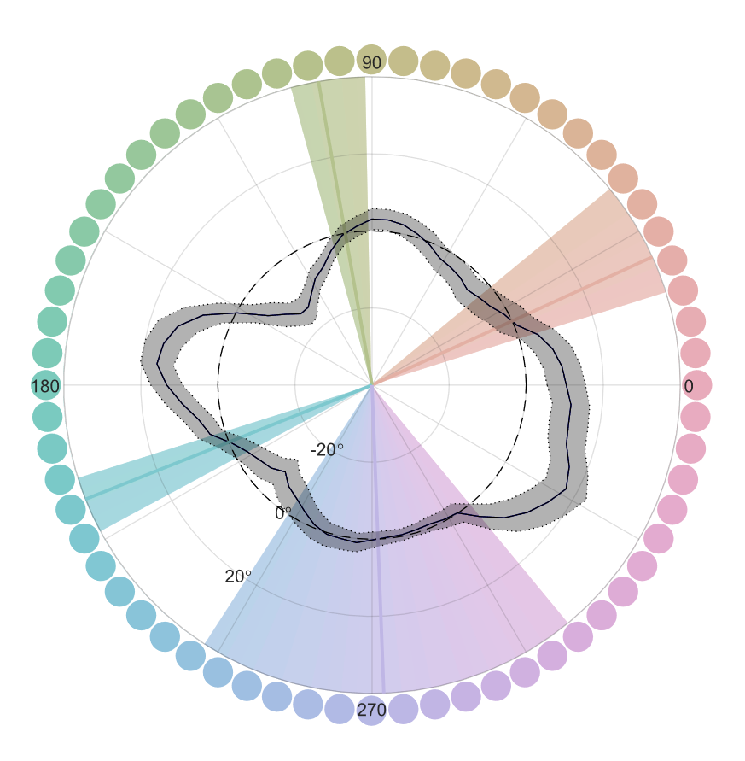
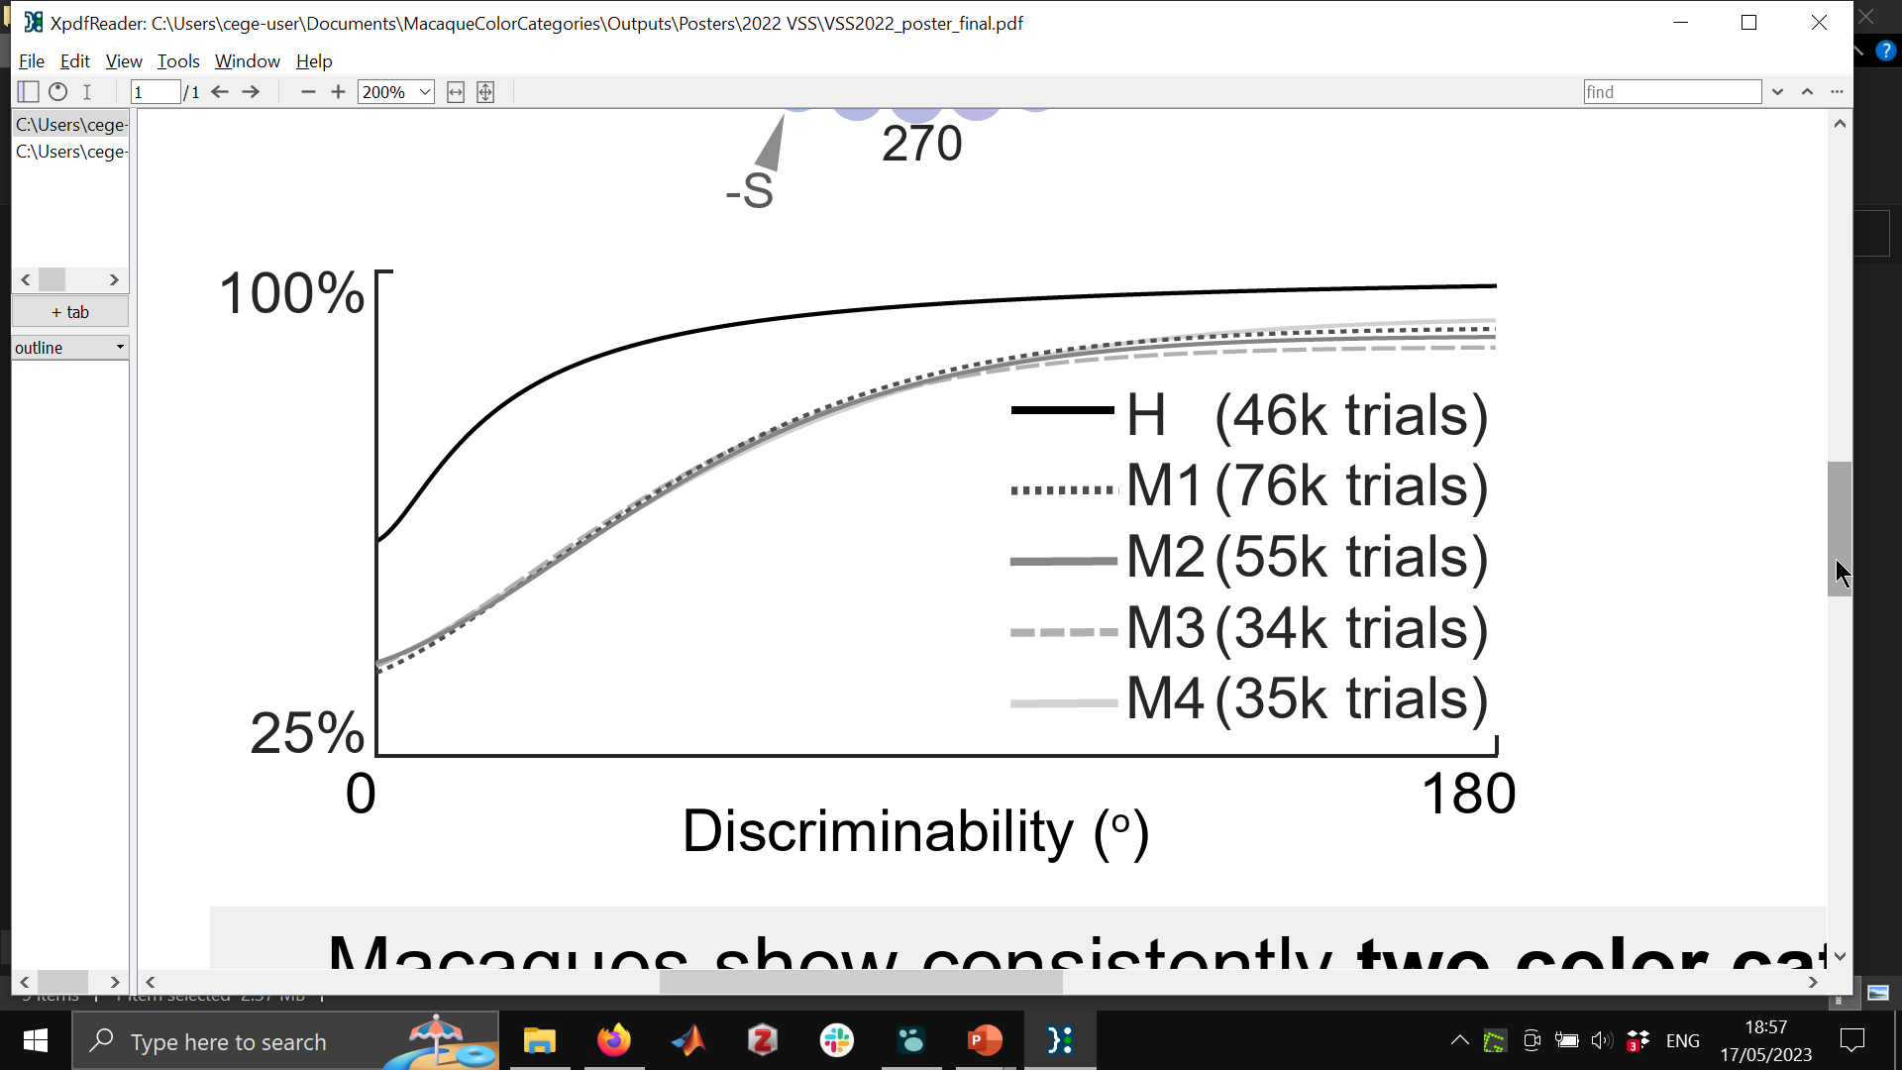
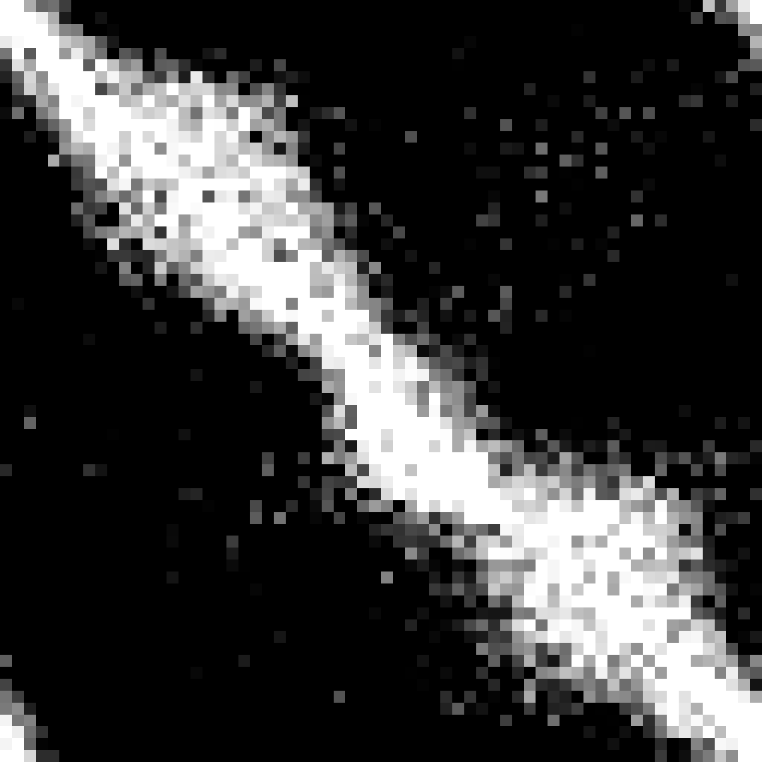
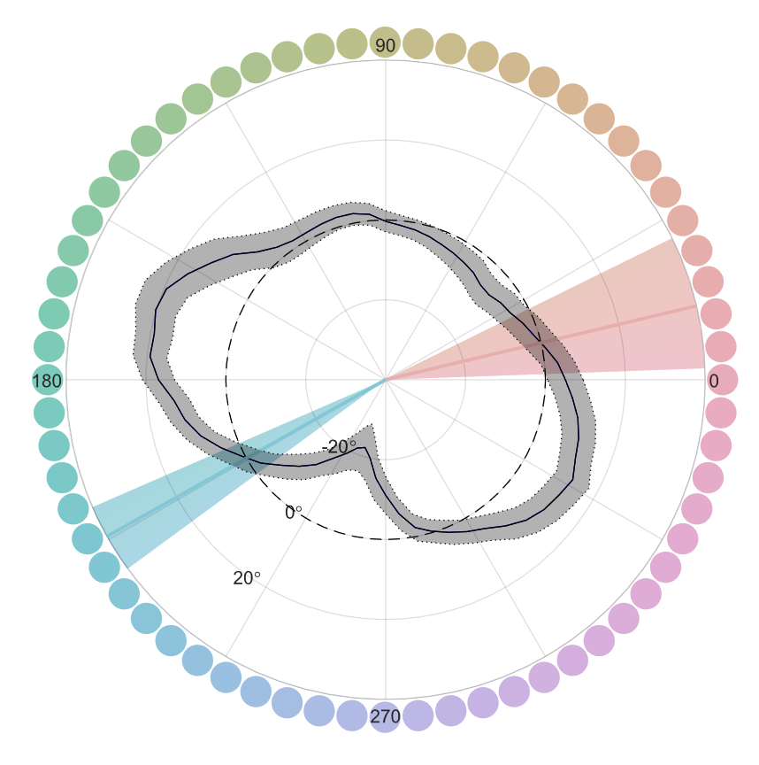
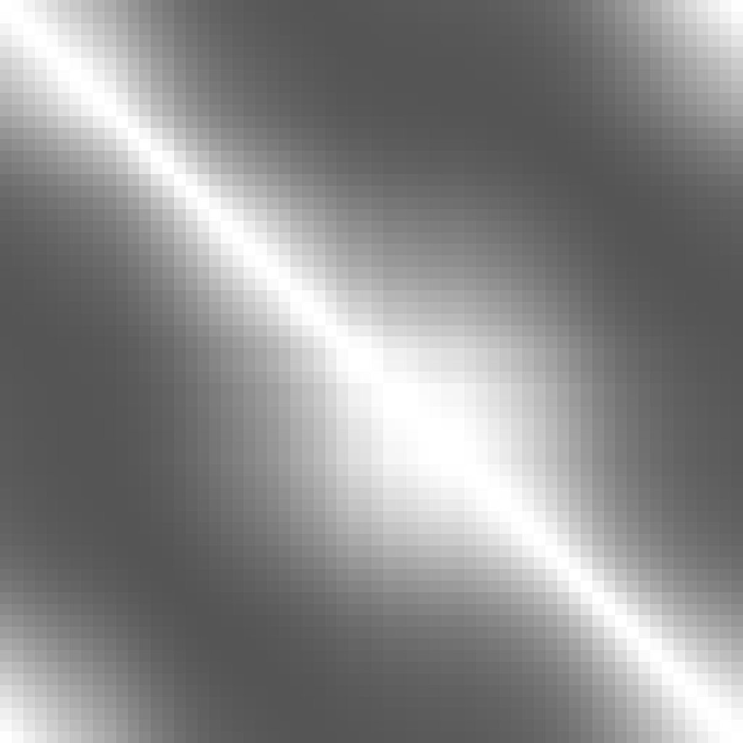
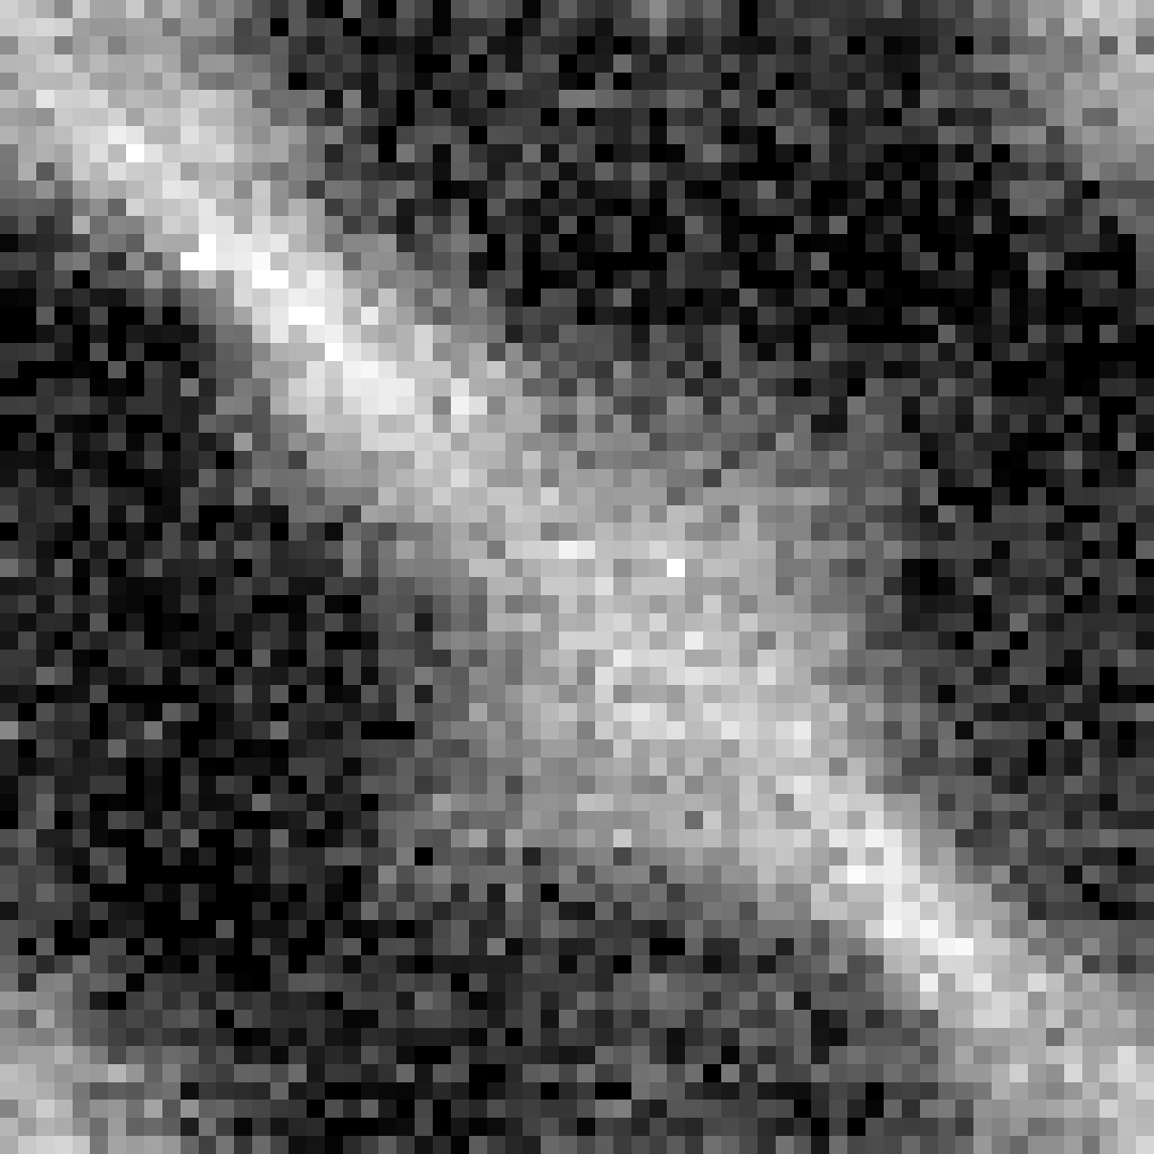
Working memory and the source of color categories in macaques
Daniel Garside, Hannah Selwyn, Neha Sriram, Alexis Green, Josh Fuller-Deets, Bevil Conway
National Eye Institute, National Institutes of Health
Color is used extensively in the study of working memory.
Bae+ (2015) showed there were biases in remembering colors over short timescales and interpreted these as evidence of color categories.
Their approach provides a non-linguistic test of color categories which can be used in trichromatic monkeys.
We identify two distinct potential sources of bias:
A behaviorally-derived uniform colorspace
1. Cognitive Bias:
2. Stimulus-Space
Non-uniformity:
One color is remembered as another
Chromatic relations extracted from stimulus-space
non-uniformity model
Color categories in monkeys
More confusable distractors on one side than
on other
Uniform sampling
from CIELUV
Cue
Cue
Individual differences:
M2’s yellow is a (one-sided) cognitive bias
100%
Similarity
Similarity
Choice
Choice
Accuracy
Similar mixture model results
25%
Similarity
Hardest trials
Easiest trials
Conclusions:
There are two attractor points found in all monkeys
These correspond roughly to the human warm and cool
At the group level, the attractors are explained by non-uniformity in the stimulus-space
At the individual level, some animals show more than the two common attractor points
Idiosyncratic attractors appear to be explained by cognitive biases
We have developed a method to distinguish sources of bias
The behavioral data can be used to reconstruct a colorspace that is free from stimulus-space non-uniformities
Mixture modelling results in 2 attractor points
for data combined across animals:
Fitting generative models to the data:
Stimulus-space non-uniformity similarity matrix
Free similarity matrix
Bibliography:
Bae, G.-Y., Olkkonen, M., Allred, S. R., & Flombaum, J. I. (2015). Why some colors appear more memorable than others: A model combining categories and particulars in color working memory. Journal of Experimental Psychology: General, 144(4), 744–763. https://doi.org/10.1037/xge0000076
Schurgin, M. W., Wixted, J. T., & Brady, T. F. (2020). Psychophysical scaling reveals a unified theory of visual memory strength. Nature Human Behaviour, 4(11), 1156–1172. https://doi.org/10.1038/s41562-020-00938-0
Bias
(peak of gaussian)
Cue
Cue
Similarity
Similarity
Choice
Choice

